Slide 1

Big Data Project
By: Harry Cavell

Slide 2

Tool: AWS
Created account and used free tier as much as possible.
Used multiple tools within AWS, including: Lake Formation, Glue, Athena, S3, and more.

Slide 3

Data: IMDb
Used Amazon Data Exchange to get student access to a massive IMDb dataset.
Multiple tables included information on movie and show titles, actors, directors, ratings, and more.
Hundreds of millions of data points included.

Slide 4
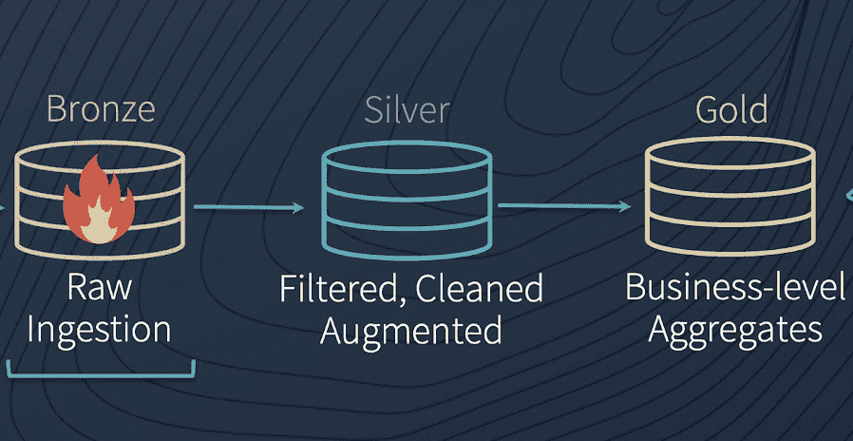
Creating a Data Lake
Create new user with IAM with full administrative access to database.
Used Amazon S3 to create a single bucket with different folders.
Bronze: Ingest data in raw format (batch and stream).
Silver: Duplicated data in uniform and columnar format.
Gold: Highest quality of data used for business insights (did not achieve this).
Register folders as data lake locations (Lake Formation).
Having multiple layers helps address the 3 V’s—greater ability to handle big data.

Slide 5
Ingesting Data into the Data Lake
In the bronze bucket, create subfolder called ”ingest.”
In ingest, create subfolder for each table.
Upload each table with corresponding subfolder within “ingest.”
Create database in Lake Formation.
Create a crawler using Glue for each folder, give it database permissions, and run it to extract data, transform it into tables, and load it into the database.

Slide 6

Analyzing the Data
Create a new folder in the data lake for query results.
Use Athena to query data using SQL.
Performed analysis of titles, actors, directors, genres, and more.

Slide 7
Streaming Data
IMDb updates data daily, but I was unable to stream real-time IMDb data, because I was not given access.
I was able to get a feel for the streaming capabilities of AWS by streaming demo data using Kinesis Firehose.
Created a crawler for the streamed data, created a new table in the database with partitions (d/m/y),

Slide 8
Transform the Data into Parquet Format
Take existing data and make it columnar, uniform, and query-able.
Create a Glue Job to perform this ETL.
Similar to creating “data cubes” in KMBI.
This becomes our “silver” database or bucket.

Slide 9
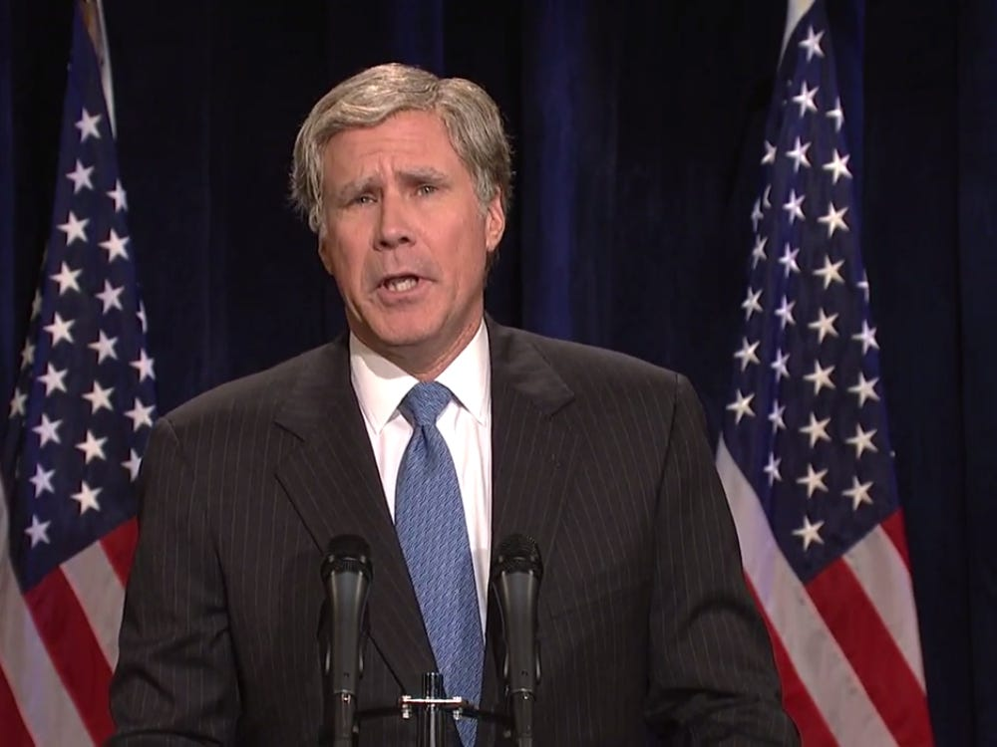

Fun Facts I Learned
Will Smith played George W. Bush on SNL in 2000.
Tom Cruise wasn’t the only actor named Tom born in 1962.
TV shows and shorts tend to be rated higher, but usually have less votes than movies.
The Hobbit films are not as highly rated as they should be.

Slide 10

What Went Well
I learned a ton about AWS—creating data lakes, databases, administrative roles, Glue jobs, etc.
It was good to get back into SQL to relearn some old skills.
My data set was large and challenging but it pushed me to understand AWS better.

Slide 11

What Did Not Go Well
There are so many tiny intricacies with AWS and on small mistake can derail you.
Didn’t know where to get started.
Limited by my lack of knowledge.
Data set was difficult to work with at times due to size, separate tables, and other factors.

Slide 12
What I Would Do Differently
Asked Anthony for help/taken the Summer offering.
Picked a data set I was more familiar with.
Left more time to try ML applications or other analytical tools.

